Slide 1
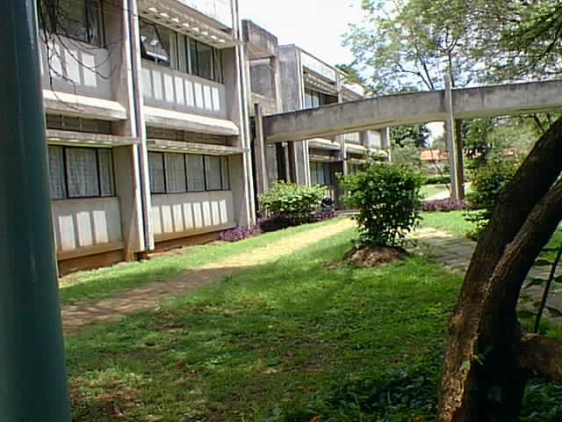
TUBERCULOUS MENINGITIS
Mini Round Presentation: Tue 26th April 2005
Presentants and Discussants from Ward 3B, Group A

Slide 2
Biodata
Name: Naomi Chesang.
Age:6/12
Sex: Female
D.O.A: 22nd April 05
P/C
Inability to open right eye - 3/7
Neck swelling - 4/7

Slide 3
HPI
The patient visited KNH Pediatric clinic on the 29th March 2005 with complains of
difficulty in breathing
Cough
Fever
The cough was persistent with production of saliva and yellow mucous.
The fever was intermittent, occurred at around 3am and 4pm. Resolved with calpol/paracetamol

Slide 4
Patient was then given an injection(mother cannot remember)and 2 syrups- Clavulin and Ibumex.
The cough resolved but the patient then eveloped a neck swelling on the left side for 3days( Mothe says it was submandibular) which then developed into a similar swelling on the right side.

Slide 5
The baby developed inability to open her right eye, this was at all times as well as well as a stiff neck. The eye started by being red and mum says it was painful. There was no dicharge nor photophobia prior to this.
The symptoms were accompanied by fever for which the mum would give calpol and paracetamol syrup, would resolve but again recur within 1hr.
The day prior to admission, the patient developed a slight jerk in her left hand along with upward rolling of the eyes.

Slide 6
PMH
The patient has been suffering from recurrent pneumonias since Dec'04. Has been visiting the Ngara Health Centre and a private clinic where she has been on Amoxil, Paracetamol, Piriton.
Perinatal History.
The patient was an abandoned child who was picked behind a mosque in Ngara by a good samaritan who is now the adoptive mother. The baby was then taken to a nearby health centre and was estimated to be 1mth old.

Slide 7
Her wgt at 1mth was 5.6kgs. She had dropped to 5.2 at admission( March 28 th 05)
She is currently 4.8kgs.
Immunisation
Complete as per KEPI Schedule

Slide 8
FH/SH
Is the 4th child in a family of 4 siblings. Other 3 are alive and well. Both parents are alive and well.
There is no Hx of smoking or drinking by any family member.
Father is employed at office of the president and mother is a house wife.
They live together with two other girls who are aunties to the patient in a 1b/rm house

Slide 9
Growth and Development
Social smile- 3/12
Sitting- 4/12
Has regressed, currently unable to sit or hold neck up.
Diet
Milk(cows) + water
Has been fed on uji and milk + water since 3/12

Slide 10
Summary
Naomi is a 6/12 old baby with c/o neck stiffness, inability to open lef eye, and neck swelling.

Slide 11
O/E
On admission,- 5/04/05
Sick looking,
Vitals- Temp: 38.8C, RR: 40b/min
No jaundice,no pallor, no cyanosis no edema. Oral thrush was present.
CNS:
Ant fontanelle- Bulging
Neck was retracted & stiff, Kernings sign =+ve
Pupils 4mm,Minimally reacting to light.
Muscle bulk- reduced and tone was normal.

Slide 12
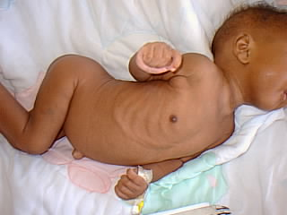

Slide 13
CVS:
S1 S2 normal with no murmurs.
Resp syst :
Mild SCR &ICR, Clear lung fields.
P/A:
Soft, no organomegally.
NB: Episthotonus started on 12/4/05.

Slide 14
Current exam: 26/04/05
Sick looking, good hydration status,but wasted in episthotonus position.
Wght= 4.8kg, 64% of expected.
LMUAC- 10CM
No oedema, no pallor, no jaundice, no LN, oral thrush present.
Vitals: Temp: 38.8C,(febrile) RR- 32b/min, PR: 130bts/min

Slide 15
CVS: NAD
Resp system
Coarse crepts over lft lung field.
P/A : NAD
CNS: Child was conscious
Head: Tense ant fontanelle, posterior fontanelle open
Head circumference= 40cm
No tenderness, sutures closed.

Slide 16
Neck:
Stiff and retracted
Kernigs- +ve
Brudzinski- +ve
Spine:
Curved inwards, no other abnormality.
Cranial nerves.
Pupils: Normal size & shape,slowly reacting to light.
Direct reflex: Present on both

Slide 17
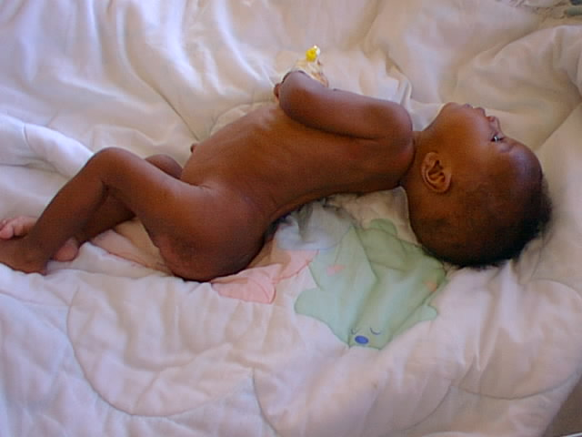

Slide 18
Consensual reaction- Shone on left,seen on right.
- Shone on right, not ellicited
EOMM- Good in all directions
Ptosis on right eye, nasolabial fold on right side is less prominent.
Motor
Muscle bulk- decreased
Tone- globbally increased.
Reflexes- Increase deep reflxes, superficial-absent
Movt of neck to right side restricted.

Slide 19
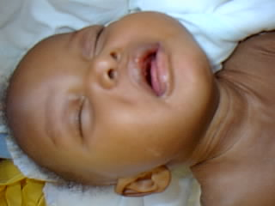
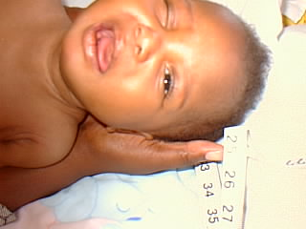

Slide 20
Impression:
-Meningitis secondary to:
TB,
Other bacterial causes,
Viral causes
-Space occupying lesion.
-Cranial nerve palsy
-Haemorrhage
-Infarction
-Abscess

Slide 21
Plan/ Investigations.
04/04/05
RBS done at casualty = 6.0mmols/l
Noted that patient was too weak for LP
5/04/05
BS for mps - Negative
6/04/05
1. FBC.
WBC: 2.2* 109/l
Neutrophils: 67%
Lymphocytes: 33%

Slide 22
RBC: 4.81 * 10 12/L
HGM: 8.80g/l
HCT: 30.1%
MCV: 62.5 fl
MCH: 18.5pg
MCHC: 29.2g/dl
Plts: 697* 10⁹/l
Microcytic Hypochromic Anaemia
2. ESR: 30mm/hr
3. Elisa: P24 markers negative.
4. CXR
5.CT Scan

Slide 23
MANAGEMENT.
Supportive Care
Day 1- IVF- Ringers Lactate 375mls over 4 hrs
- Monitor vital signs 3hrly
Day 2 – Nutritional support – NAN 1 70ls every 3hrs by mouth
Day 4 – NGT feeding – NAN 1 70mls 3hrly
Day 5 – Physiotherapy started
Day 6 – Ventilatory support via 0xygen mask
Day 9 – Feed increased upto 90mls 3hrly
Day 11- Monitoring vital signs 6hrly daily

Slide 24
Specific Treatment
Day 1- Xpen
CAF
Paracetamol
Clotrimazole oral drops
Day 2 – TEO applied TID for conjutivitis
Day 3 – Rocehin
Dexamethasone
Rifater

Slide 25
Specific Treatment cont’d
Day 4 – Streptomycin
Rifatar
Day 7 – Cetamol
Day 18 – Rocephin
Diamox (acetazolamide)
Cetamol

